Slide 1
Lesson 12
The transfiguration
October 14, 2020
Lesson Review

Slide 2
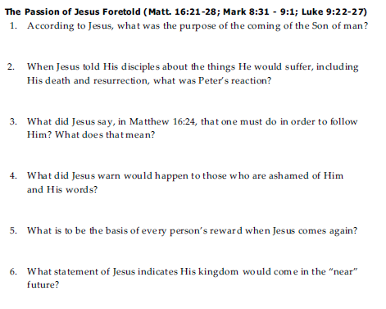
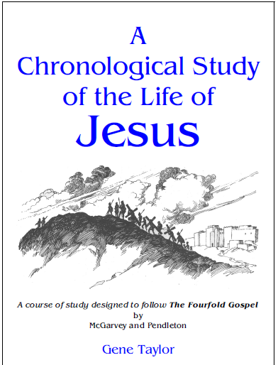
Lesson 12 Review Questions

Slide 3
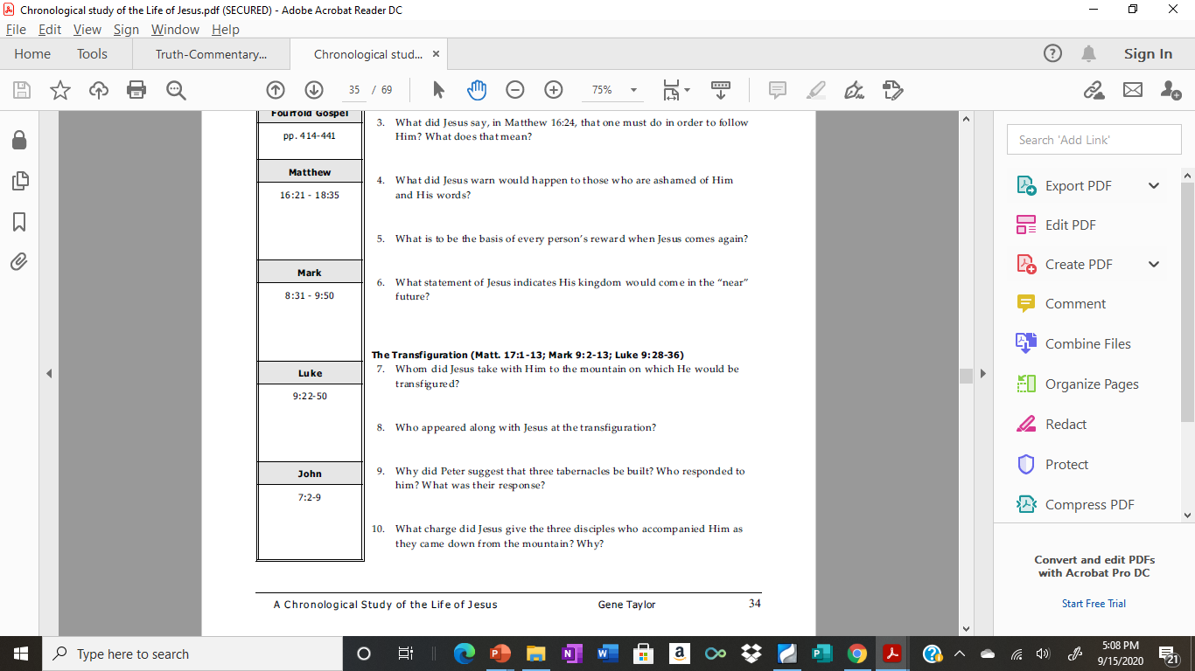
Lesson 12 Review Questions

Slide 4
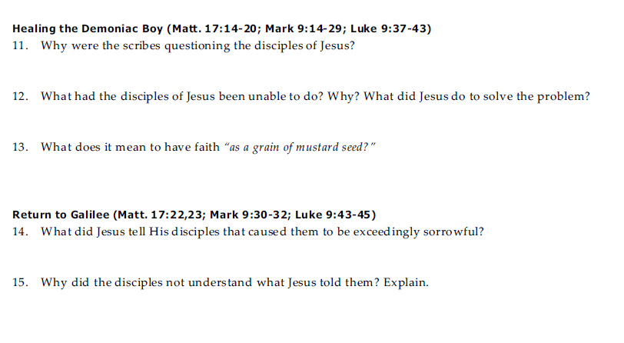

Lesson 12 Review Questions

Slide 5
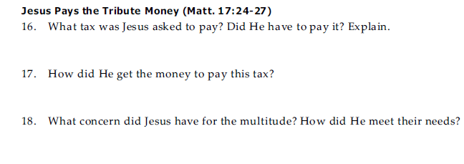
Lesson 12 Review Questions

Slide 6
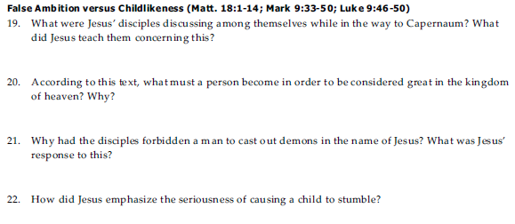

Lesson 12 Review Questions

Slide 7

Lesson 12 Review Questions

